Slide 1



PROFIT PROPHETS Jennifer Montgomery

Slide 2


Profit Prophets:
We predicting Success with Precision.

Slide 3
resentation
Data Analysis
Customer Portrait
Deeper insights in the data set
Presenting customer demands & underlying interests
Investment Cases
Schedule
Presentation of best investment cases
Advisory on market timing, both buy & sell side

Slide 4


01
Data
Analysis

Slide 5
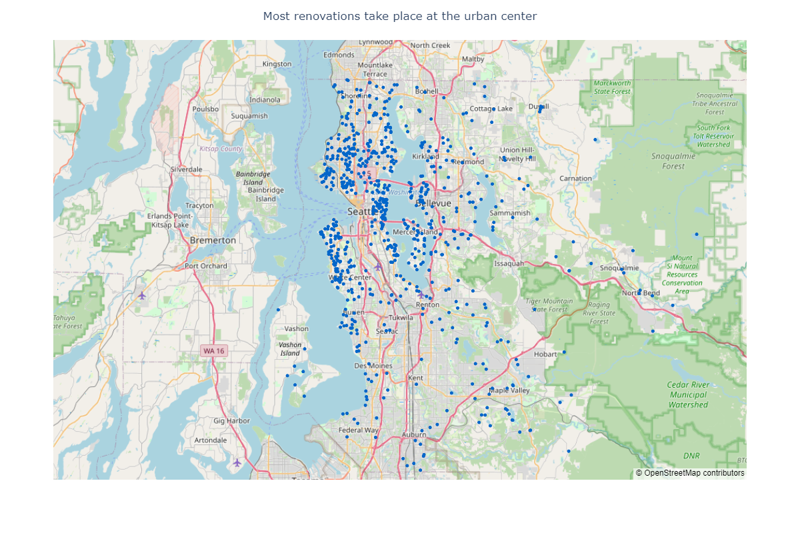
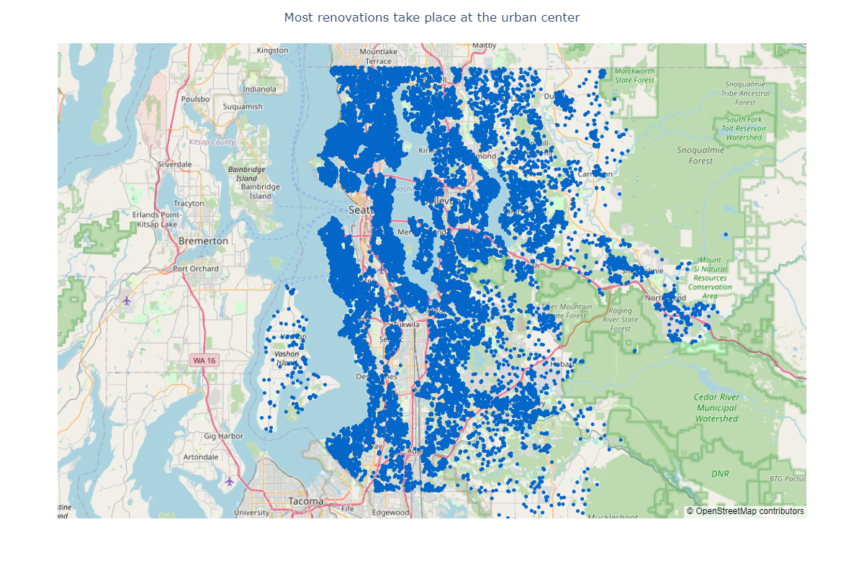
Focus: Renovations
Where did people renovate?
City center way more renovated than outer ‘rural’ area
Caveat: not normalized by population / all data points
Houses that have been renovated

Slide 6
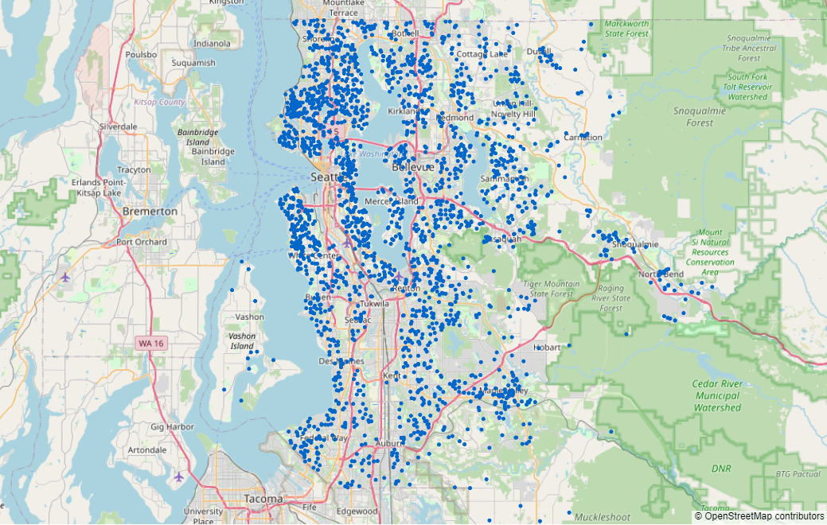
Focus: Data fixing
Can we reduce NaN for waterfront?
Many cases where no lake or river is nearby
How to isolate those cases?
Houses with missing data for waterfront

Slide 7
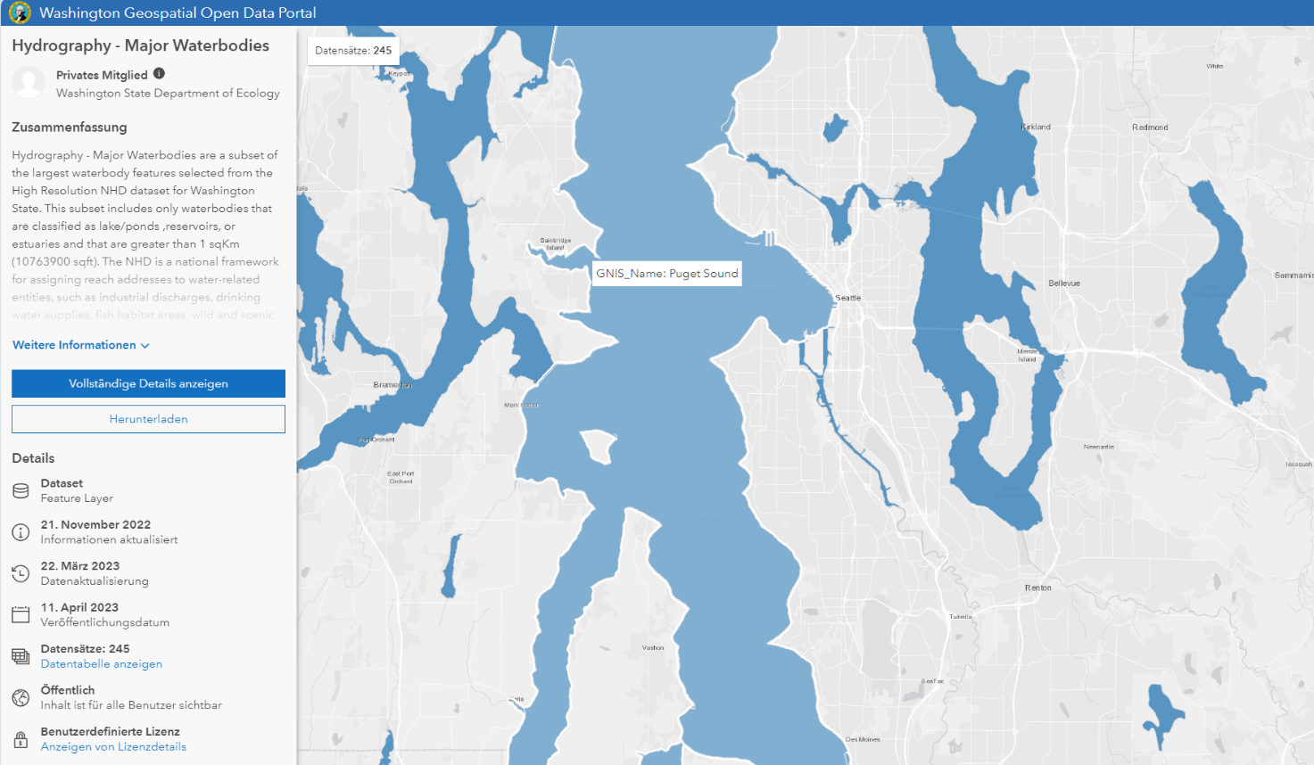
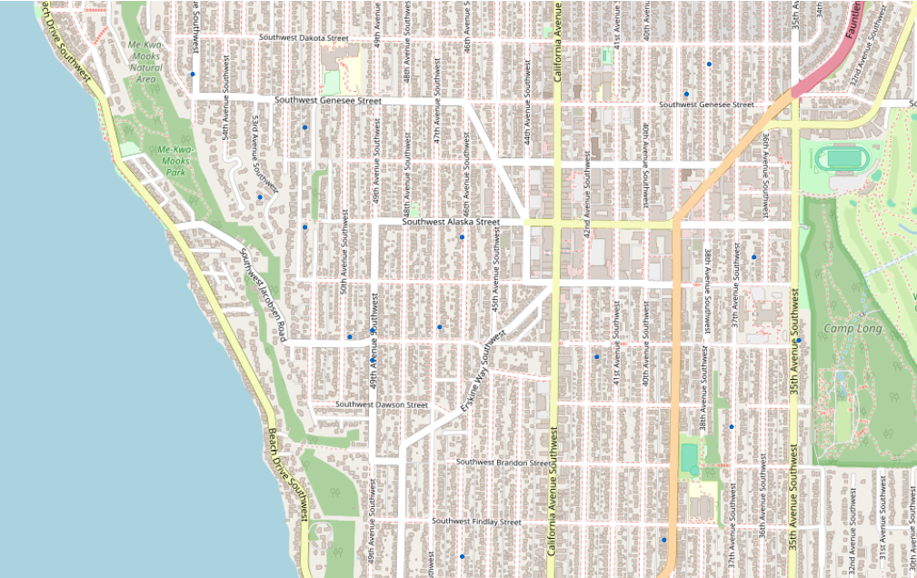
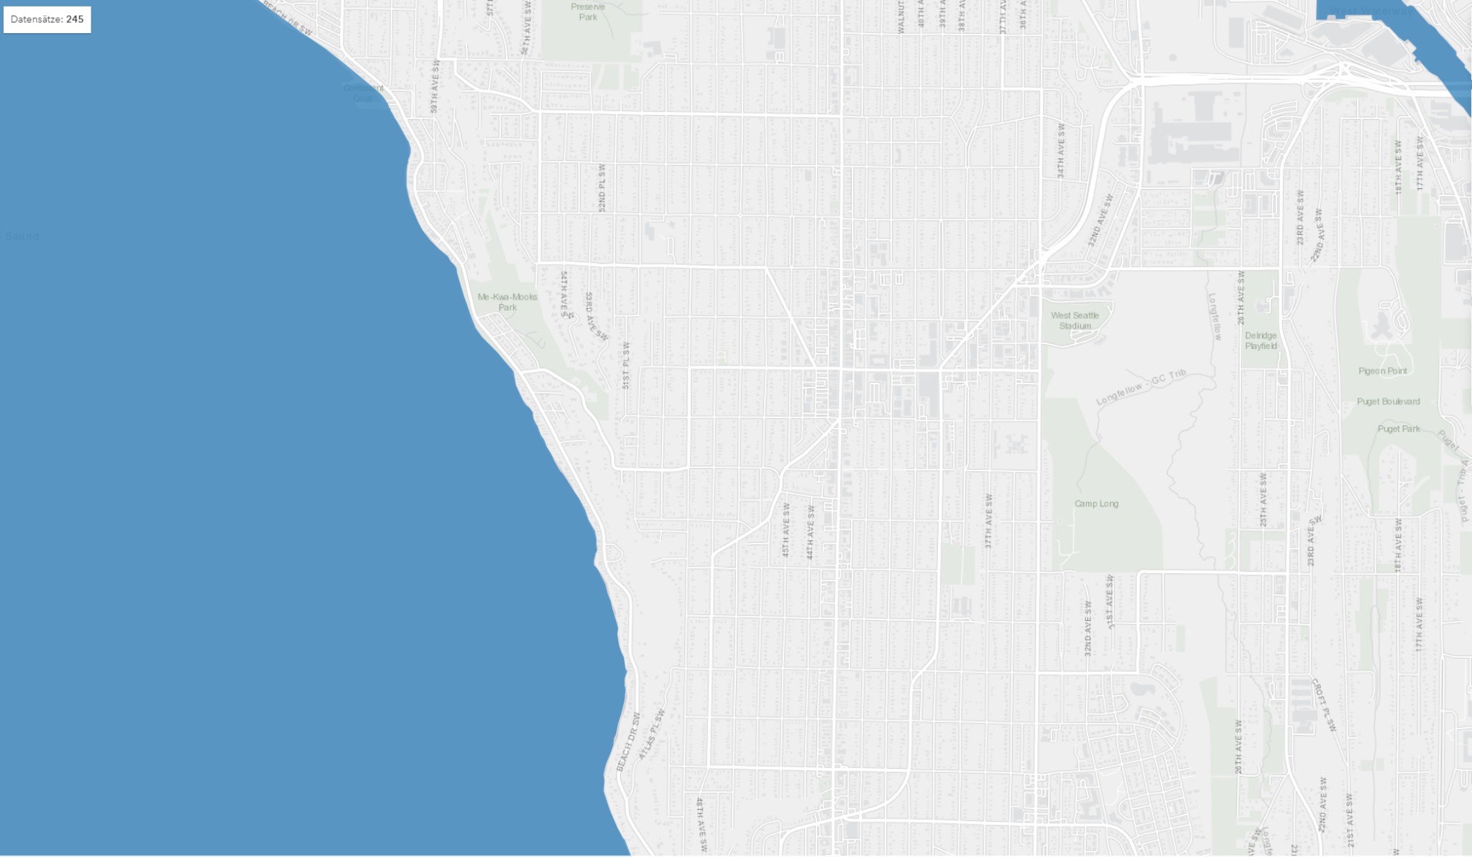
Focus: Data fixing
Can we reduce NaN for waterfront?
Data point
b²
a²
Polygons with water bodies (lakes, rivers etc.)
c²
Closest water body coordinate
Fetching of closest water body coordinate failed for three hours
Water bodies: Washington Geospatial Open Data Portal

Slide 8
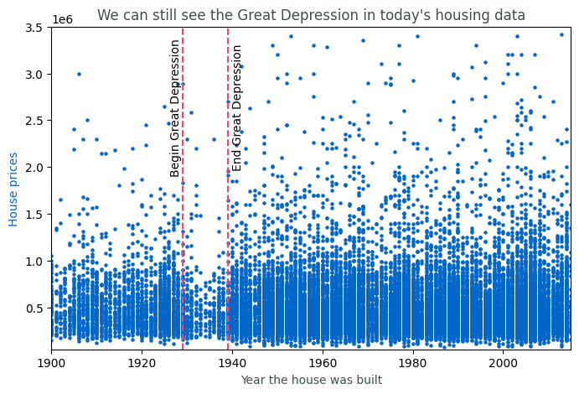
Focus: Great Depression
Can we still see the Great Depression?
Yes, it seems there are way less houses on the market from that period
But: Only first hint, let’s check closely
Houses and their prices scattered over time

Slide 9
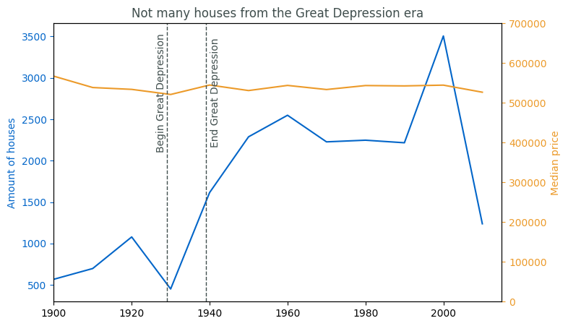
Focus: Great Depression
Can we still see the Great Depression?
Truly less houses available from that period, but prices are pretty stable over time
But when people had no money: Did they reduce their costs?
Amount and median price per decade

Slide 10
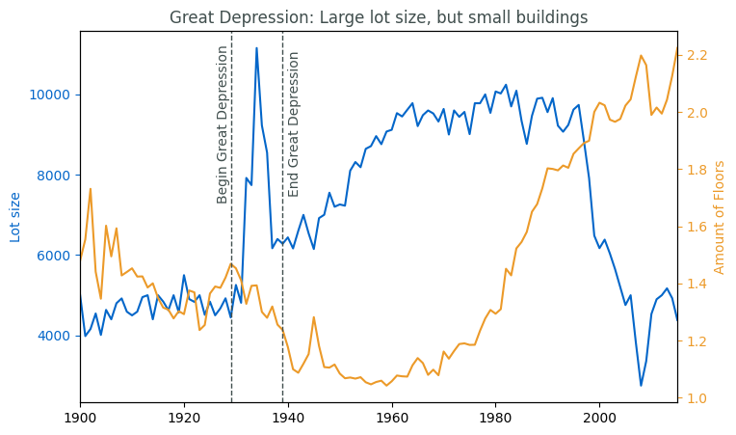
Focus: Great Depression
Can we still see the Great Depression?
Lot size did not crashed, but instead peaked during the crisis, but buildings got smaller
Did people only built smaller houses? Or also shabbier ones?
Lot size and amount of floors over time

Slide 11
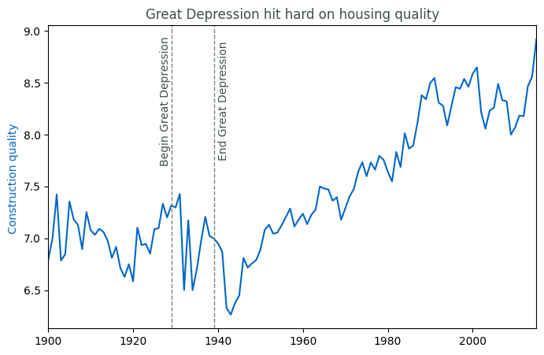
Focus: Great Depression
Can we still see the Great Depression?
Yes, quality of newly constructed buildings diminished
Strongest decrease even after the end of the Depression
Construction quality over time

Slide 12


02
Customer Portrait

Slide 13




Jenny
Montgomery
Character
Wants to show off
Wealthy | has high budget
Demands
Waterfront
Renovated
High grades
Buy: within a month
Sell: within 1 year

Slide 14


03
InvestmentCases

Slide 15
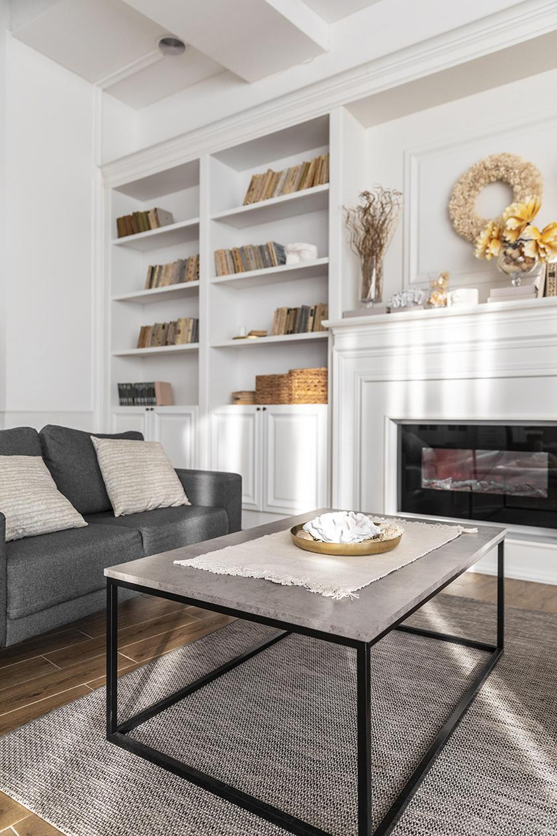
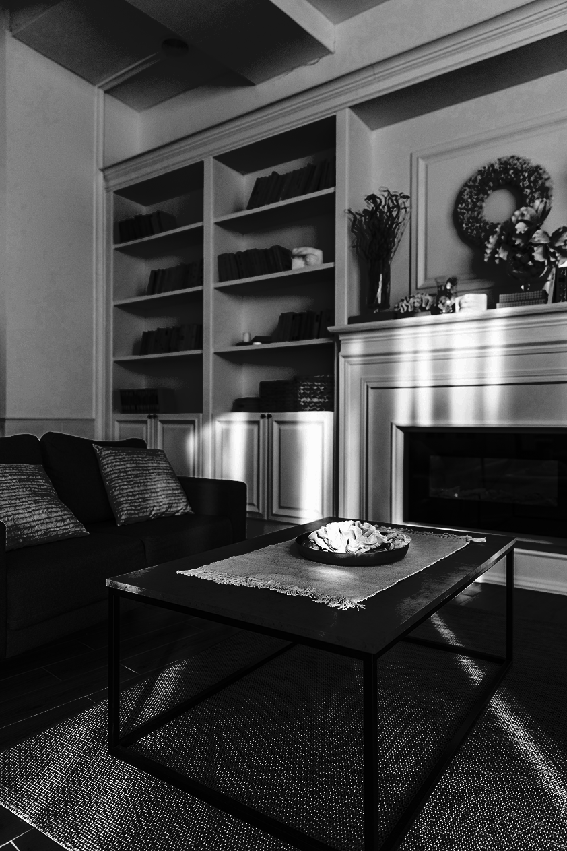
Database query
Price
Area
Waterfront
Renovation
Grade
View
Higher than 80th quantile
Lot and living area bigger than 110% of neighbours
Water nearby and line of sight
Renovation no longer than 50 years ago
Higher than 80th quantile
Higher than 95th quantile

Slide 16
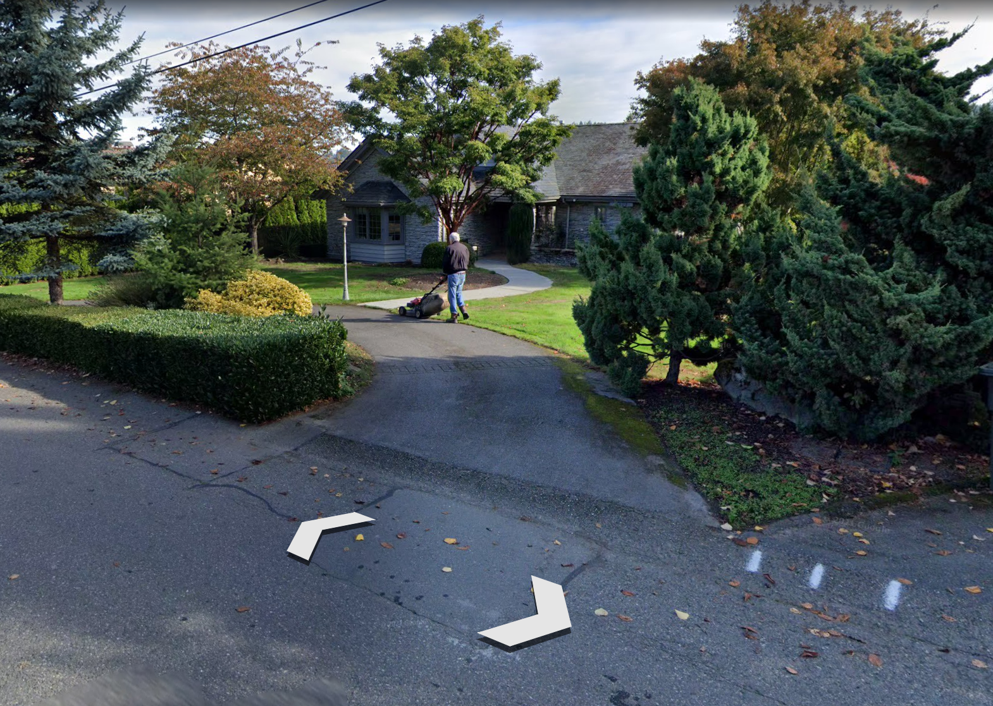

#1 Yarrow Point
365000.000
95th Ave NE
$ 749.950
Floors:
Bedrooms:
Bathrooms:
Waterfront:
View:
Grade:
Renovated:
2
5
4.5
Yes
Average
Very good
2001
The total loft is 37.325 ft2, 47% bigger than neighbours. The living area is 10.040 ft2, 155% larger than houses nearby.

Slide 17
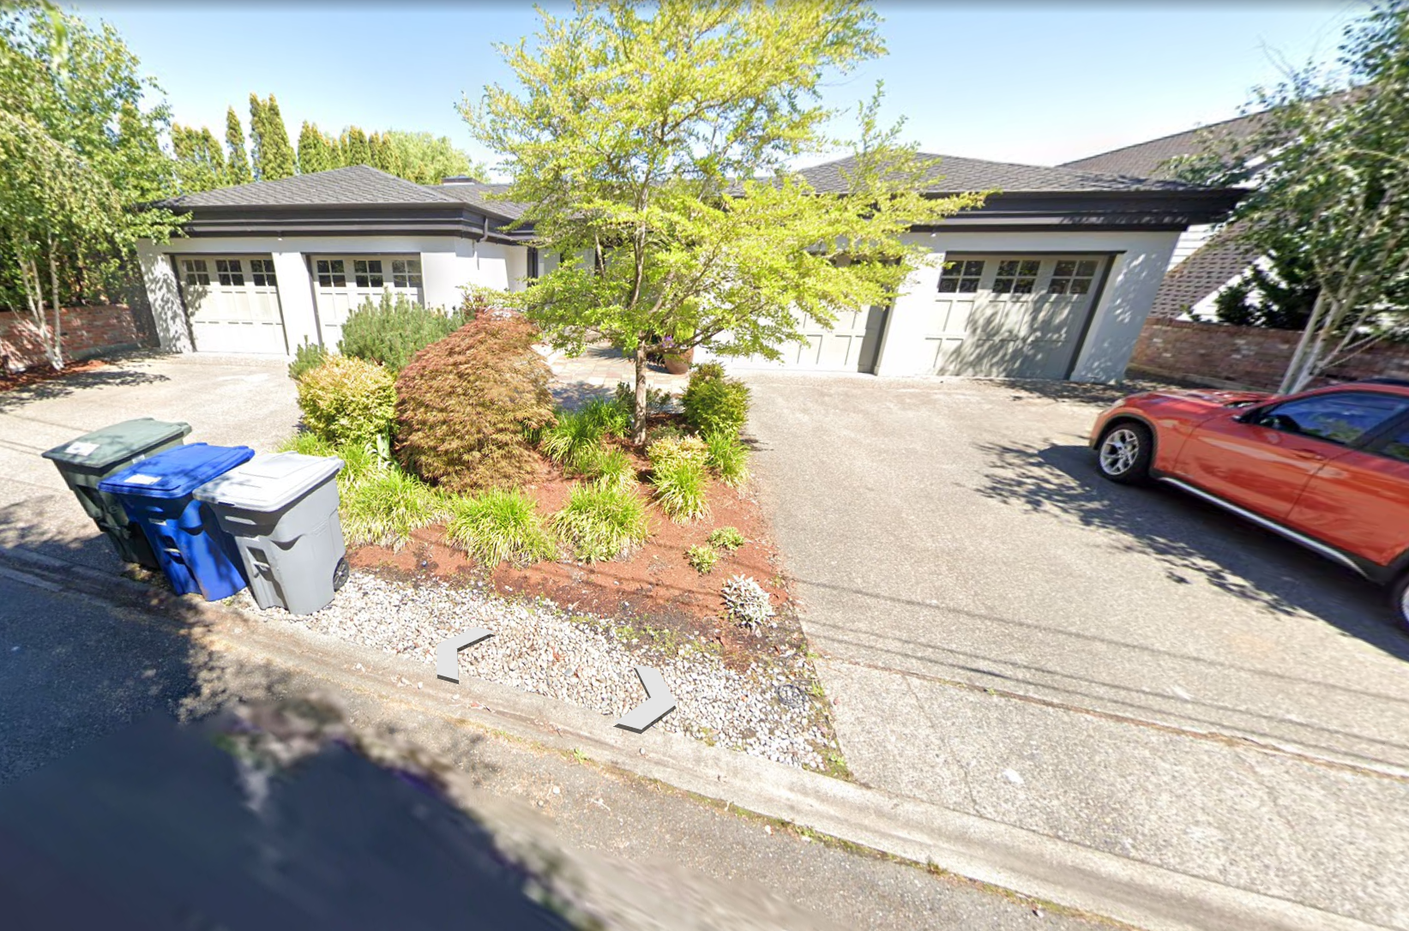
#2 Mercer Island
365000.000
Butterworth Rd
$ 775.000
Floors:
Bedrooms:
Bathrooms:
Waterfront:
View:
Grade:
Renovated:
1
5
6.75
Yes
Supreme
Extremely good
2009
The total loft is 13.068 ft2, 25% bigger than neighbours. The living area is 9.640 ft2, 1.95% larger than houses nearby.

Slide 18
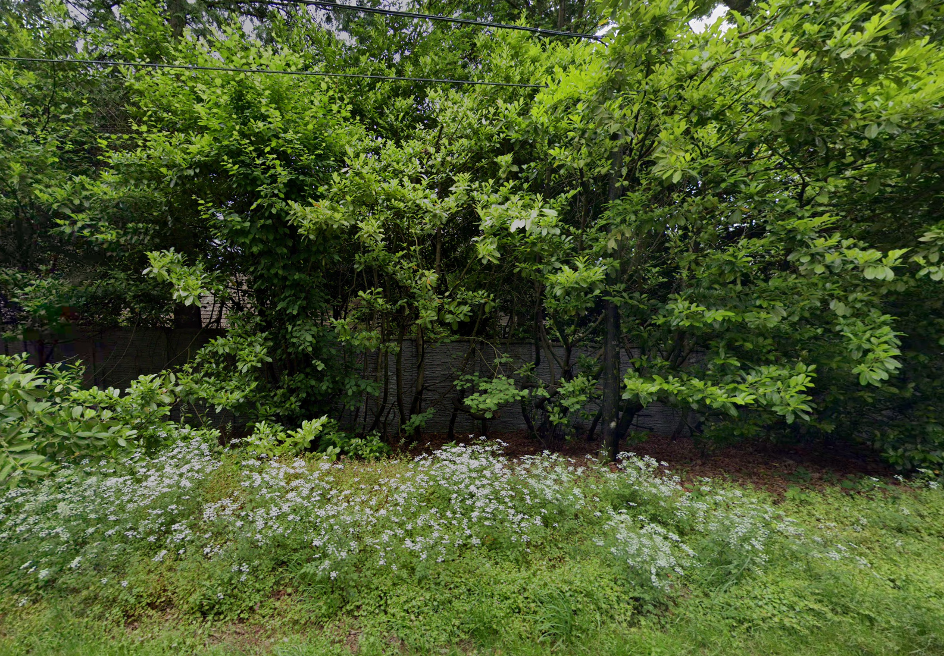
#3 Bellevue
365000.000
Lake
Sammamish
$ 1.490.000
Floors:
Bedrooms:
Bathrooms:
Waterfront:
View:
Grade:
Renovated:
1
5
3.25
Yes
Supreme
Very good
1987
The total loft is 41.300 ft2, 62% bigger than neighbours. The living area is 4.220 ft2, 11% larger than houses nearby.

Slide 19


04
Investment Schedule

Slide 20
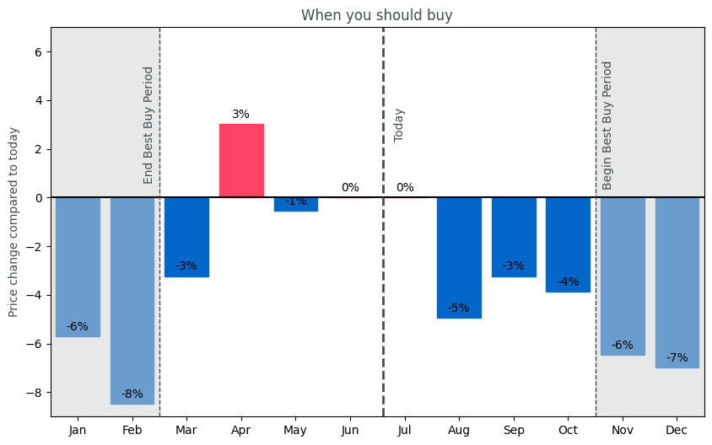
When should you buy?
Current
August
Prices are high. Purchase within a month not advisable.
Prices drop from August on
Optimal
April
Lowest prices: Nov - Feb
Don’t buy in April.
Prices are high

Slide 21
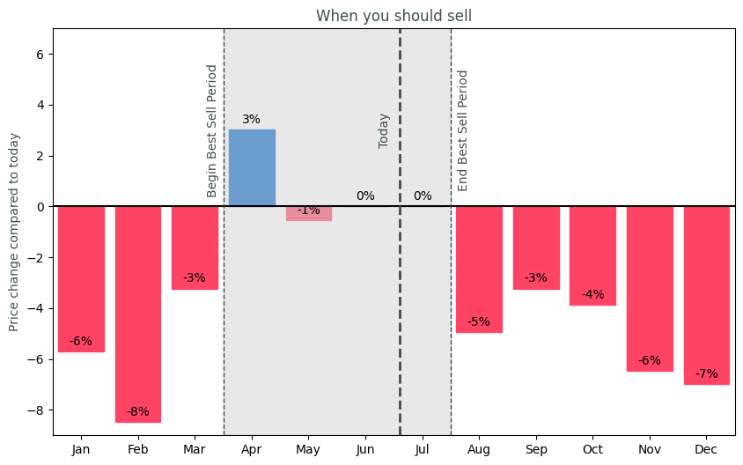
When should you sell?
Current
Optimal
Prices are a bit over average.
Best to sell in April till July.
February
April
Don’t sell in February.
Best month is April.

Slide 22



Thank you!
We predicting Success with Precision.

